Slide 1
Test plan discussion
Hair Dryer

Slide 2
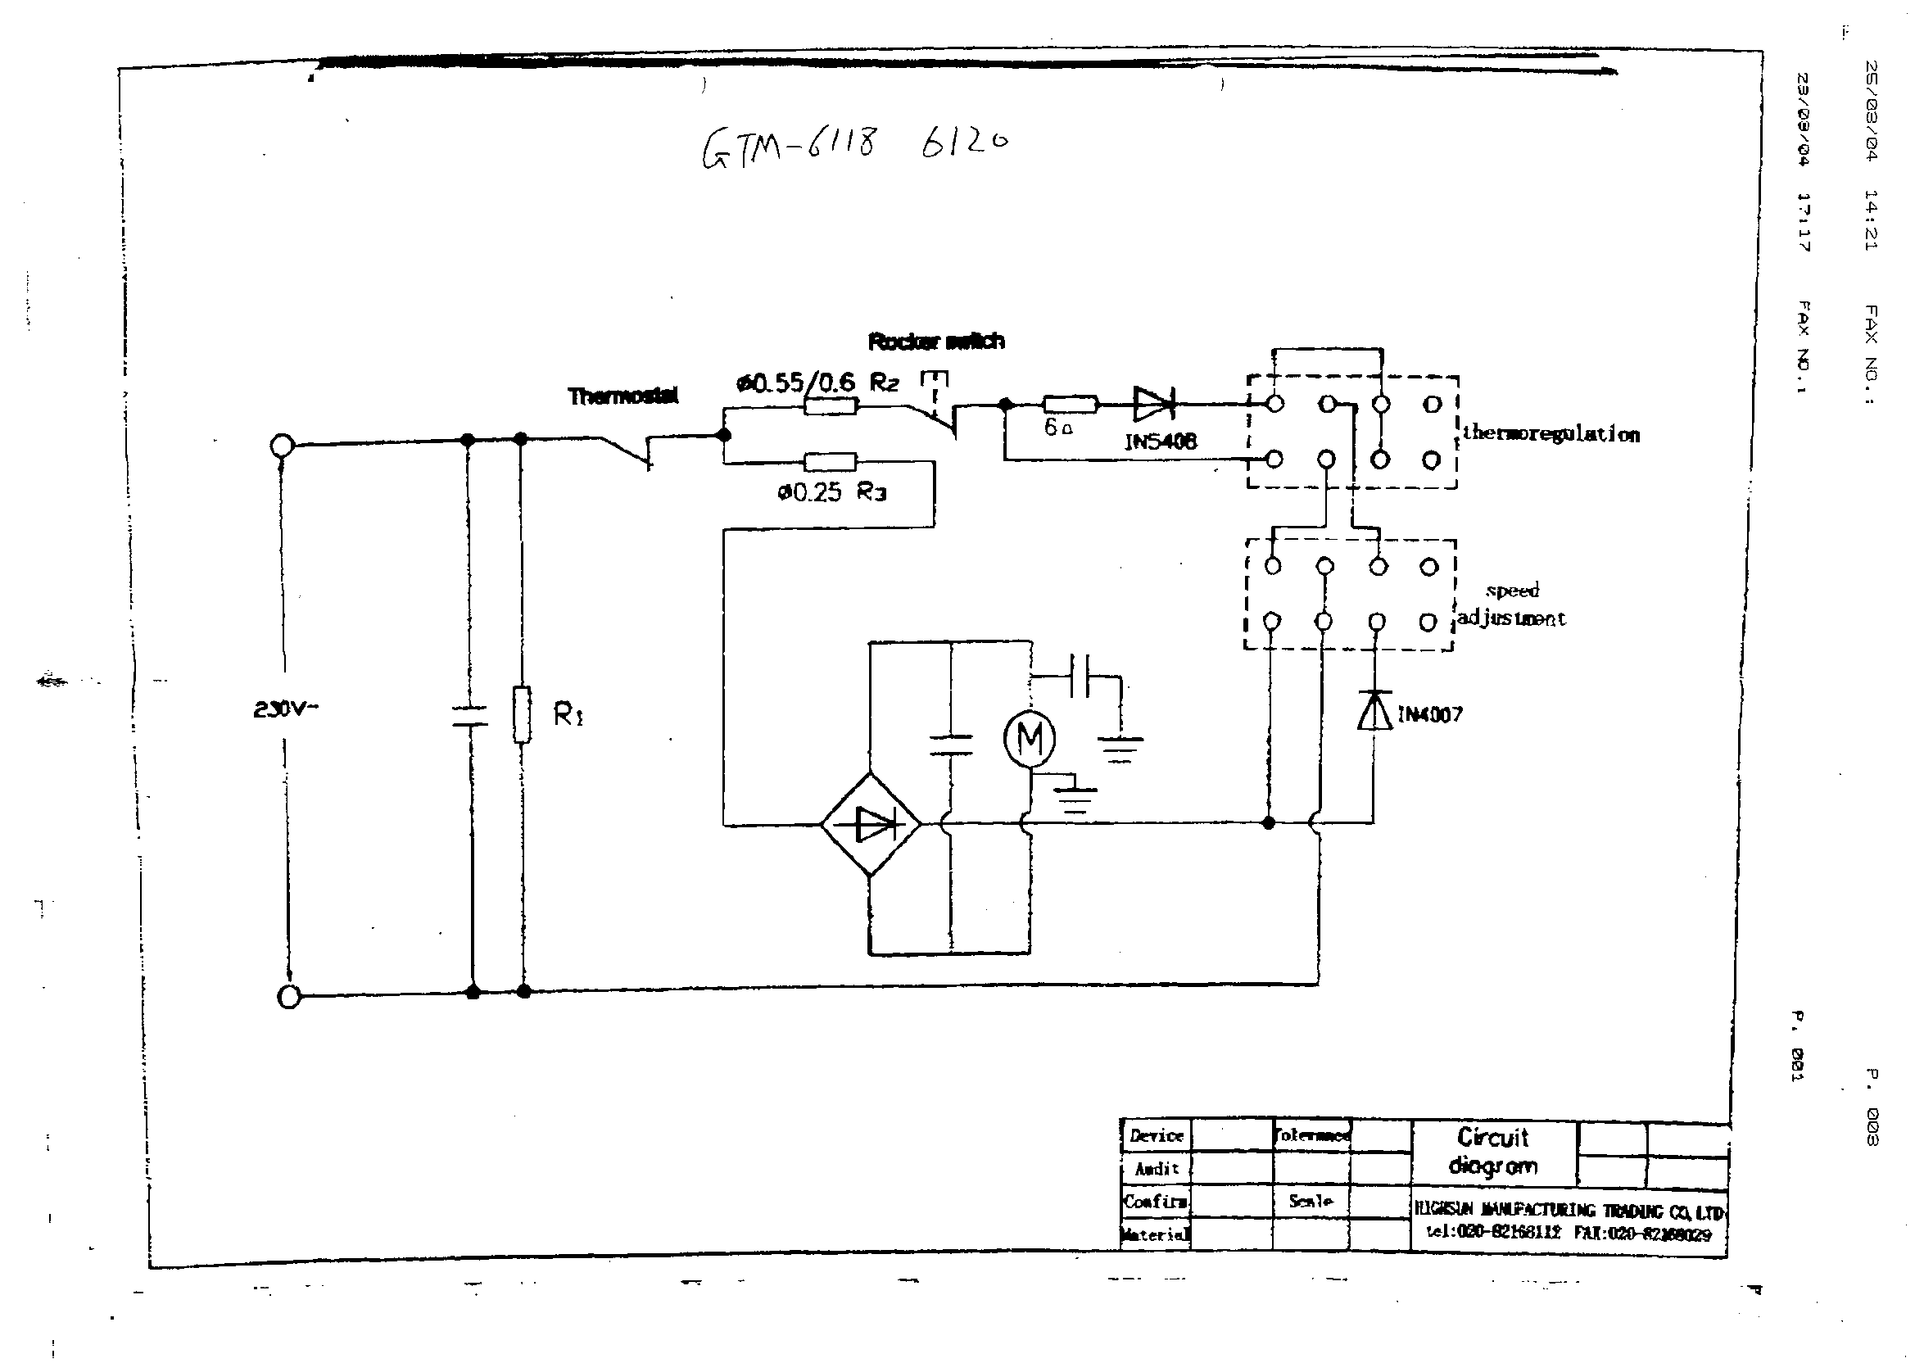
Circuit Diagram

Slide 3
Disturbance Source
diode controlling the motor + heater
DC motor --- broadband disturbance

Slide 4
Applicable standards
Nominal household appliance with motor and heater
EN 55014-1
EN 55014-2
EN 61000-3-2
EN 61000-3-3

Slide 5
Test items/operation modes
Disturbance voltage
  According to the disturbance sources analysis, DC motor and oscillator should be running during test. Therefore,
  operation mode: damper in 2nd knead stage selected according to the program chart
Disturbance power
  Same as above
Click

Slide 6
Test items/operation modes
Harmonics
  Heater does not provide harmonics in this case, choose stage with motor running, e.g. damper at 2nd knead
Flicker
  According to the disturbance source analysis, back

